Slide 1

Exhaustive Search Algorithm
(Exhaustive – Uninformed - Blind Search)
Artificial Intelligence
School of Computing
Universiti Teknologi Malaysia

Slide 2
Outline
Selection of a Search Strategy
  Breadth-first
  Depth-first
  Comparison of both search strategy
Using State Space to Represent Reasoning
  And/or graph
  Hypergraph

Slide 3
Selection of a Search Strategy
  Breadth-first
  Depth-first
  Comparison of both search strategy

Slide 4
Selection of a Search Strategy
Most of the effort is often spent on the selection of an appropriate search strategy for a given problem
  Uninformed search (blind..exhaustive search)
    number of steps, path cost unknown
    knows when it reaches a goal
  Informed search (heuristic search)
    has background information about the problem
      map, costs of actions

Slide 5
Search Strategy : The order
Uninformed Search
Breadth-first
Informed Search
Best-first search
Depth-first
Iterative deepening
Uniform-cost search
Depth-limited search
Bi-directional search
Constraint satisfaction
Search with heuristics
Memory-bounded search
Iterative improvement search

Slide 6
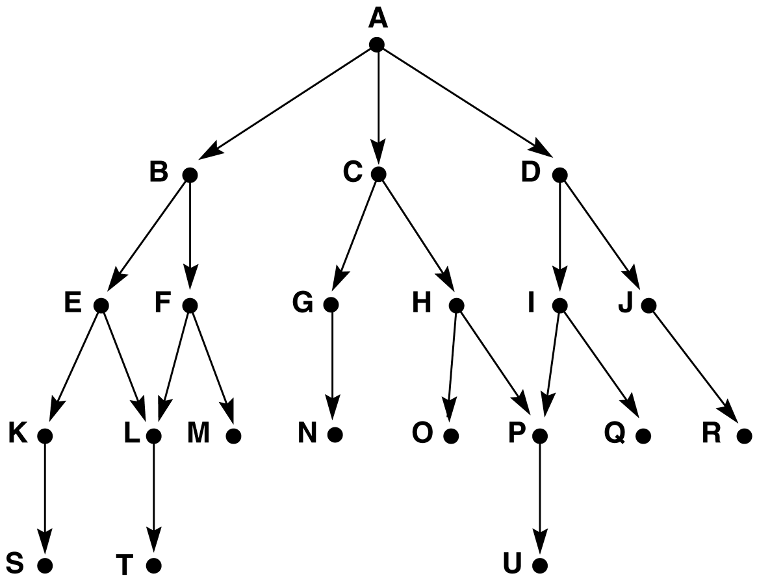

Search Strategy
Graph for breadth and depth-first search examples.
How Depth-first
How Breadth-first

Slide 7
Search Strategy : Breadth-First
All the nodes reachable from the current node are explored first
  Achieved by the TREE-SEARCH method by appending newly generated nodes at the end of the search queue
function BREADTH-FIRST-SEARCH(problem) returns solution
return TREE-SEARCH(problem, FIFO-QUEUE())
Time Complexity | b^{d+1}
Space Complexity | b^{d+1}
Completeness | yes (for finite b)
Optimality | yes (for non-negative path costs)
b | branching factor
d | depth of the tree
Solution is found

Slide 8
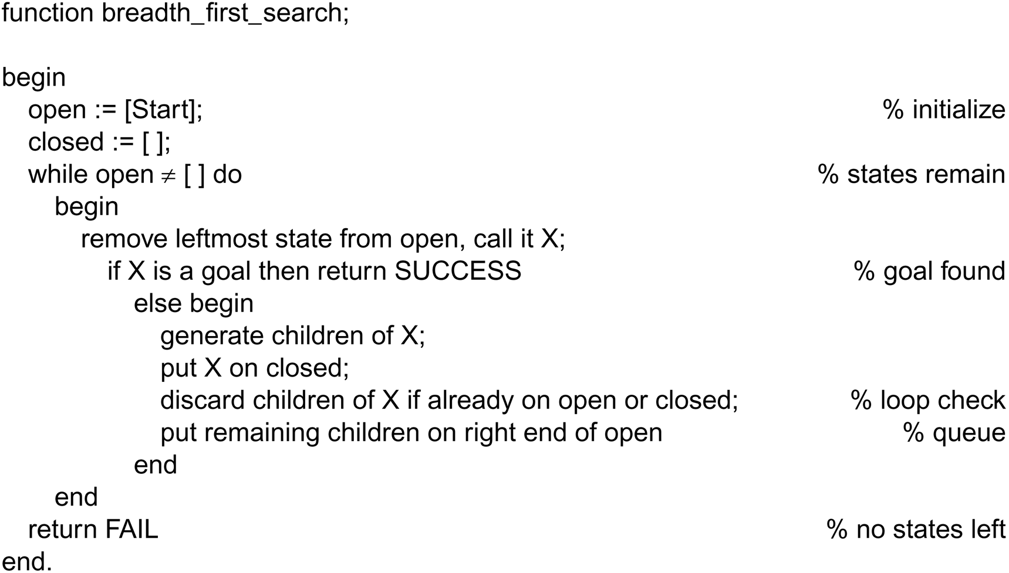
Search Strategy : Breadth-First
Function Breadth-first search algorithm

Slide 9
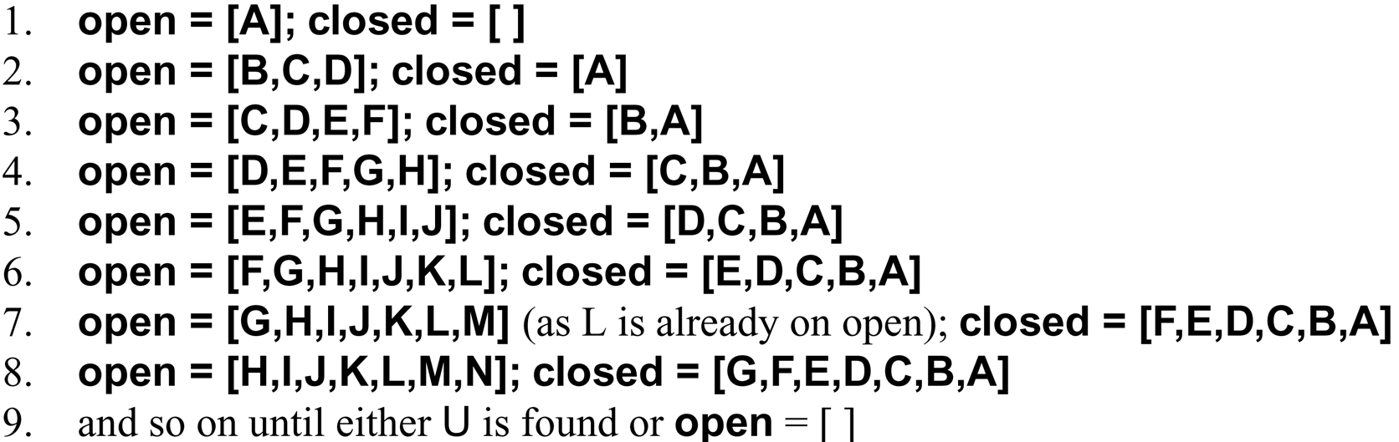
Search Strategy : Breadth-First
Function Breadth-first search algorithm

Slide 10
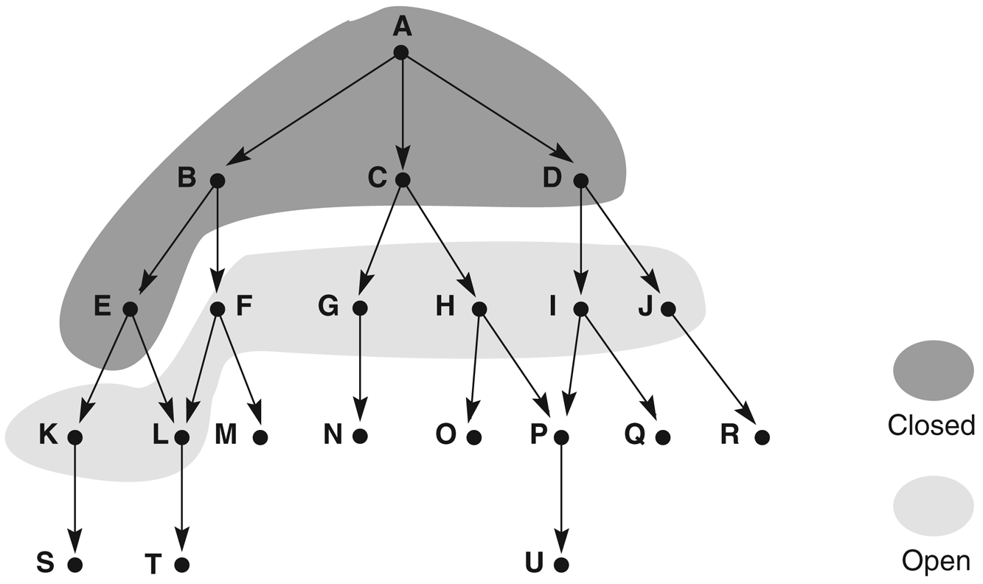
Search Strategy : Breadth-First
Function Breadth-first search algorithm
States on open and closed are highlighted.
Explore level by level
Use list open ~ NSL in backtrack – states not yet evaluated
Use list close ~ SL and DE in backtrack –states already evaluated
Which state is removed from open determines the order of search- BFS adds at the right list and removes from the left (queue-FIFO)

Slide 11
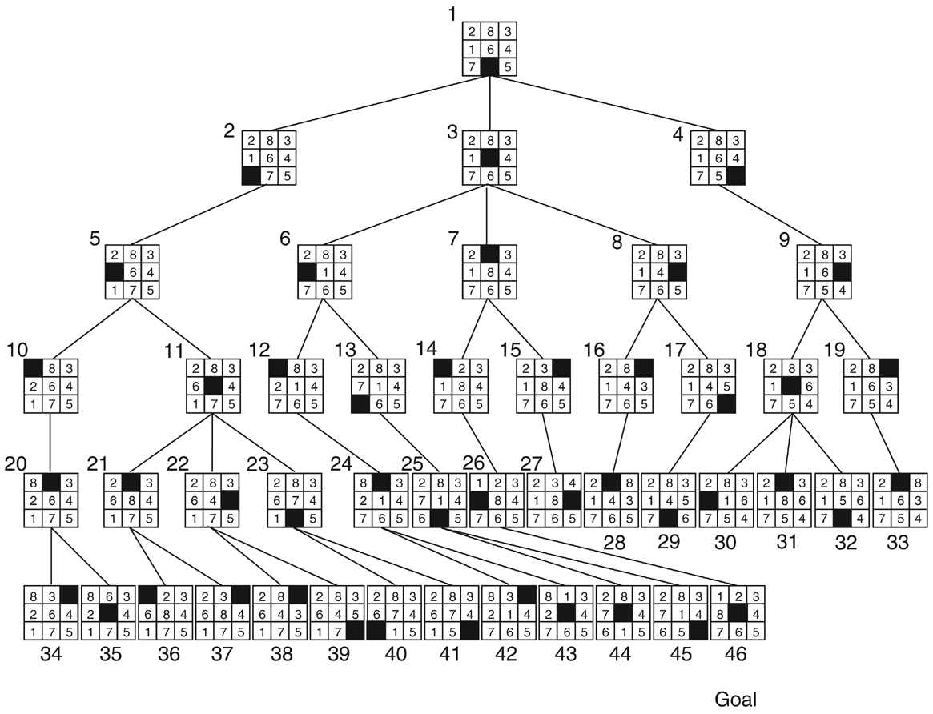
Search Strategy : Breadth-First
Breadth-first search of the 8-puzzle, showing order in which states were removed from open

Slide 12
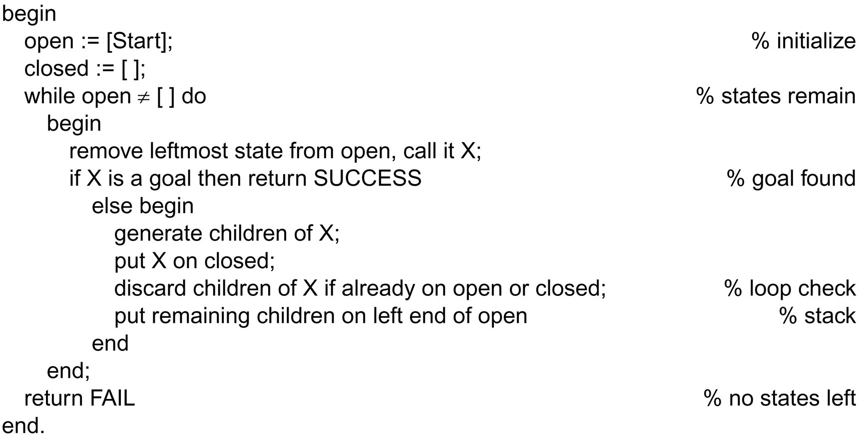
Search Strategy : Depth-First
Function Depth-first search algorithm

Slide 13
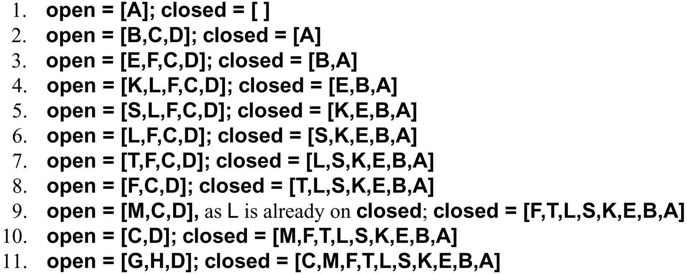
Search Strategy : Depth-First
Function Depth-first search algorithm

Slide 14
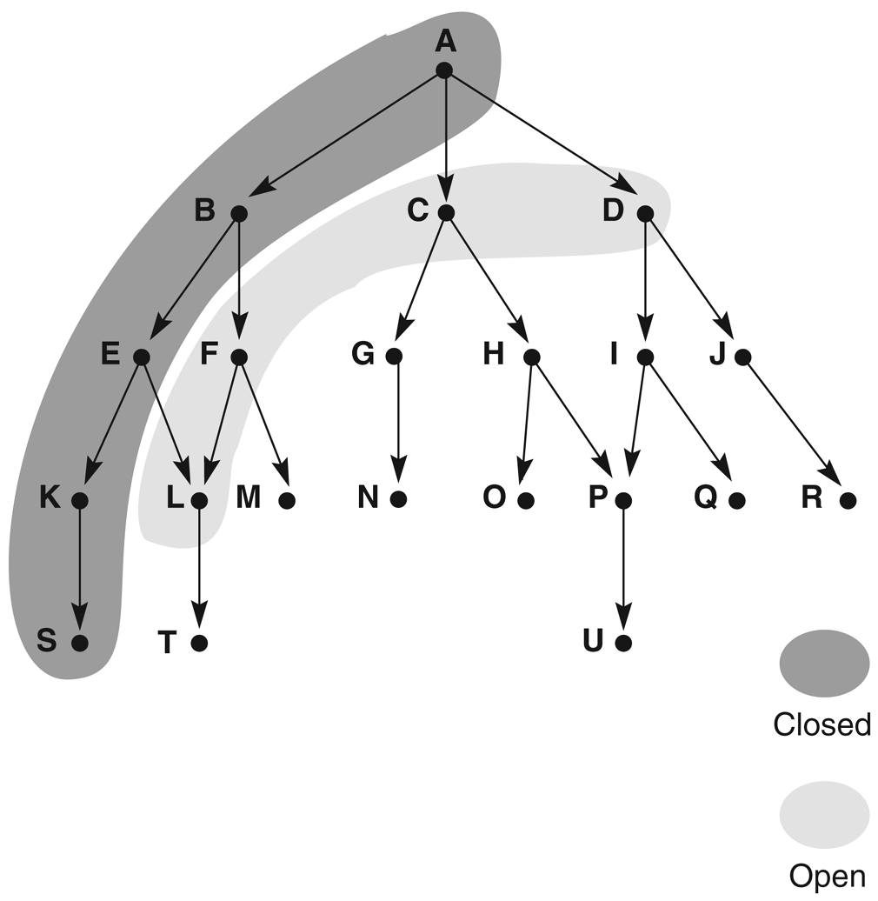
Search Strategy : Depth-First
Function Depth-first search algorithm
States on open and closed are highlighted.
Child and descendants are evaluated before siblings
Goes deeper into search space whenever possible
Which state is removed from open determines the order of search- DFS adds and removes from the left end (stack-LIFO)

Slide 15
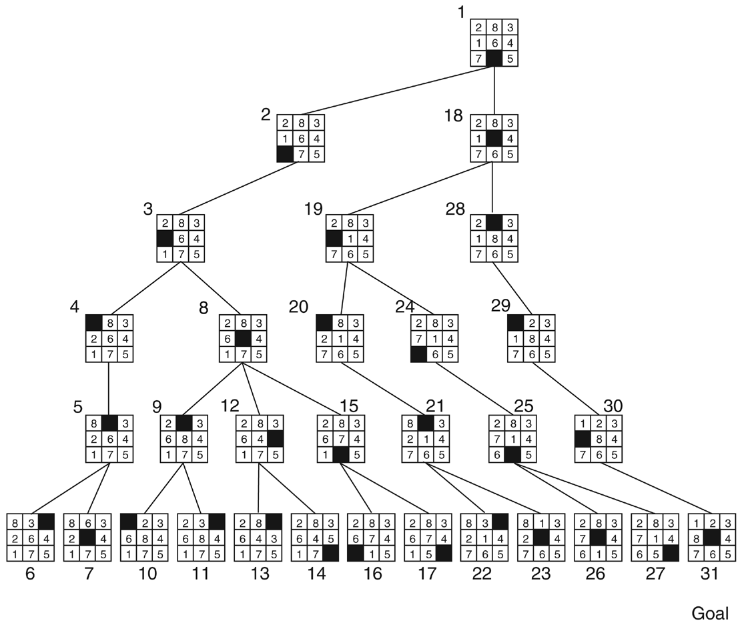
Search Strategy : Depth-First
Depth-first search of the 8-puzzle with a depth bound of 5

Slide 16
Breadth-First Snapshot 1
Initial
1
Visited
Fringe
2
3
Current
Visible
Goal
Fringe: [] + [2,3]
Notes:
The current node [1] already has been removed from the fringe, and the new ones [2,3] will be added.

Slide 17
Breadth-First Snapshot 2
Initial
1
Visited
Fringe
2
3
Current
Visible
Goal
4
5
Fringe: [3] + [4,5]

Slide 18
Breadth-First Snapshot 3
Initial
1
Visited
Fringe
2
3
Current
Visible
Goal
4
5
6
7
Fringe: [4,5] + [6,7]

Slide 19
Breadth-First Snapshot 4
Initial
1
Visited
Fringe
2
3
Current
Visible
Goal
4
5
6
7
8
9
Fringe: [5,6,7] + [8,9]

Slide 20
Breadth-First Snapshot 5
Initial
1
Visited
Fringe
2
3
Current
Visible
Goal
4
5
6
7
8
9
10
11
Fringe: [6,7,8,9] + [10,11]

Slide 21
Breadth-First Snapshot 6
Initial
1
Visited
Fringe
2
3
Current
Visible
Goal
4
5
6
7
8
9
10
11
12
13
Fringe: [7,8,9,10,11] + [12,13]

Slide 22
Breadth-First Snapshot 7
Initial
1
Visited
Fringe
2
3
Current
Visible
Goal
4
5
6
7
8
9
10
11
12
13
14
15
Fringe: [8,9.10,11,12,13] + [14,15]

Slide 23
Breadth-First Snapshot 8
Initial
1
Visited
Fringe
2
3
Current
Visible
Goal
4
5
6
7
8
9
10
11
12
13
14
15
16
17
Fringe: [9,10,11,12,13,14,15] + [16,17]

Slide 24
Breadth-First Snapshot 9
Initial
1
Visited
Fringe
2
3
Current
Visible
Goal
4
5
6
7
8
9
10
11
12
13
14
15
16
17
18
19
Fringe: [10,11,12,13,14,15,16,17] + [18,19]

Slide 25
Breadth-First Snapshot 10
Initial
1
Visited
Fringe
2
3
Current
Visible
Goal
4
5
6
7
8
9
10
11
12
13
14
15
16
17
18
19
20
21
Fringe: [11,12,13,14,15,16,17,18,19] + [20,21]

Slide 26
Breadth-First Snapshot 11
Initial
1
Visited
Fringe
2
3
Current
Visible
Goal
4
5
6
7
8
9
10
11
12
13
14
15
16
17
18
19
20
21
22
23
Fringe: [12, 13, 14, 15, 16, 17, 18, 19, 20, 21] + [22,23]

Slide 27
Breadth-First Snapshot 12
Initial
1
Visited
Fringe
2
3
Current
Visible
Goal
4
5
6
7
Note:
The goal node is “visible” here, but we can not perform the goal test yet.
8
9
10
11
12
13
14
15
16
17
18
19
20
21
22
23
24
25
Fringe: [13,14,15,16,17,18,19,20,21] + [22,23]

Slide 28
Breadth-First Snapshot 13
Initial
1
Visited
Fringe
2
3
Current
Visible
Goal
4
5
6
7
8
9
10
11
12
13
14
15
16
17
18
19
20
21
22
23
24
25
26
27
Fringe: [14,15,16,17,18,19,20,21,22,23,24,25] + [26,27]

Slide 29
Breadth-First Snapshot 14
Initial
1
Visited
Fringe
2
3
Current
Visible
Goal
4
5
6
7
8
9
10
11
12
13
14
15
16
17
18
19
20
21
22
23
24
25
26
27
28
29
Fringe: [15,16,17,18,19,20,21,22,23,24,25,26,27] + [28,29]

Slide 30
Breadth-First Snapshot 15
Initial
1
Visited
Fringe
2
3
Current
Visible
Goal
4
5
6
7
8
9
10
11
12
13
14
15
16
17
18
19
20
21
22
23
24
25
26
27
28
29
30
31
Fringe: [15,16,17,18,19,20,21,22,23,24,25,26,27,28,29] + [30,31]

Slide 31
Breadth-First Snapshot 17
Initial
1
Visited
Fringe
2
3
Current
Visible
Goal
4
5
6
7
8
9
10
11
12
13
14
15
16
17
18
19
20
21
22
23
24
25
26
27
28
29
30
31
Fringe: [18,19,20,21,22,23,24,25,26,27,28,29,30,31]

Slide 32
Breadth-First Snapshot 18
Initial
1
Visited
Fringe
2
3
Current
Visible
Goal
4
5
6
7
8
9
10
11
12
13
14
15
16
17
18
19
20
21
22
23
24
25
26
27
28
29
30
31
Fringe: [19,20,21,22,23,24,25,26,27,28,29,30,31]

Slide 33
Breadth-First Snapshot 19
Initial
1
Visited
Fringe
2
3
Current
Visible
Goal
4
5
6
7
8
9
10
11
12
13
14
15
16
17
18
19
20
21
22
23
24
25
26
27
28
29
30
31
Fringe: [20,21,22,23,24,25,26,27,28,29,30,31]

Slide 34
Breadth-First Snapshot 20
Initial
1
Visited
Fringe
2
3
Current
Visible
Goal
4
5
6
7
8
9
10
11
12
13
14
15
16
17
18
19
20
21
22
23
24
25
26
27
28
29
30
31
Fringe: [21,22,23,24,25,26,27,28,29,30,31]

Slide 35
Breadth-First Snapshot 21
Initial
1
Visited
Fringe
2
3
Current
Visible
Goal
4
5
6
7
8
9
10
11
12
13
14
15
16
17
18
19
20
21
22
23
24
25
26
27
28
29
30
31
Fringe: [22,23,24,25,26,27,28,29,30,31]

Slide 36
Breadth-First Snapshot 22
Initial
1
Visited
Fringe
2
3
Current
Visible
Goal
4
5
6
7
8
9
10
11
12
13
14
15
16
17
18
19
20
21
22
23
24
25
26
27
28
29
30
31
Fringe: [23,24,25,26,27,28,29,30,31]

Slide 37
Breadth-First Snapshot 23
Initial
1
Visited
Fringe
2
3
Current
Visible
Goal
4
5
6
7
8
9
10
11
12
13
14
15
16
17
18
19
20
21
22
23
24
25
26
27
28
29
30
31
Fringe: [24,25,26,27,28,29,30,31]

Slide 38
Breadth-First Snapshot 24
Initial
1
Visited
Fringe
2
3
Current
Visible
Goal
4
5
6
7
Note:
The goal test is positive for this node, and a solution is found in 24 steps.
8
9
10
11
12
13
14
15
16
17
18
19
20
21
22
23
24
25
26
27
28
29
30
31
Fringe: [25,26,27,28,29,30,31]

Slide 39
Depth-First Snapshot
Initial
1
Visited
Fringe
2
3
Current
Visible
Goal
4
5
6
7
8
9
10
11
12
13
14
15
16
17
18
19
20
21
22
23
24
25
26
27
28
29
30
31
Fringe: [3] + [22,23]

Slide 40
Activity 1: Depth-First vs. Breadth-First
Depth-first goes off into one branch until it reaches a leaf node
  Not good if the goal is on another branch
  Neither complete nor optimal
  Uses much less space than breadth-first
Question 1: Give reasons why Depth First search uses less space that breadth first?
Breadth-first is more careful by checking all alternatives
  Complete and optimal
    Under most circumstances
  But ..Very memory-intensive !!
Question 2: Give a reason why Breadth First search uses very memory-intensive?

Slide 41
Activity 1: Depth-First vs. Breadth-First
Depth-first goes off into one branch until it reaches a leaf node
  Not good if the goal is on another branch
  Neither complete nor optimal
  Uses much less space than breadth-first
    Answer #1:
      Much fewer visited nodes to keep track of
      Smaller fringe
Breadth-first is more careful by checking all alternatives
  Complete and optimal
    Under most circumstances
  But ..Very memory-intensive !!
  Answer #2:
    More specifically, BFS uses O(branchingFactor^maxDepth) or O(maxWidth) memory, where-as DFS only uses O(maxDepth).
Notes:
Answer # 2: Refer here: https://stackoverflow.com/questions/23477856/why-does-a-breadth-first-search-use-more-memory-than-depth-first

Slide 42
Using State Space to Represent Reasoning
  And/or graph
  Hypergraph

Slide 43
Using State Space to Represent Reasoning : Predicate calculus
Predicate calculus – map nodes/some states of a graph onto state space
Inference rules – describe the arc between states
Eg. Is expression a logical consequence of given assertion? Use search to solve
Guarantee correctness of conclusion derived- a formal proof of integrity of solution

Slide 44
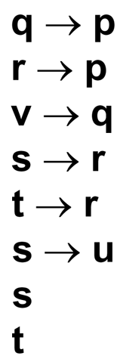
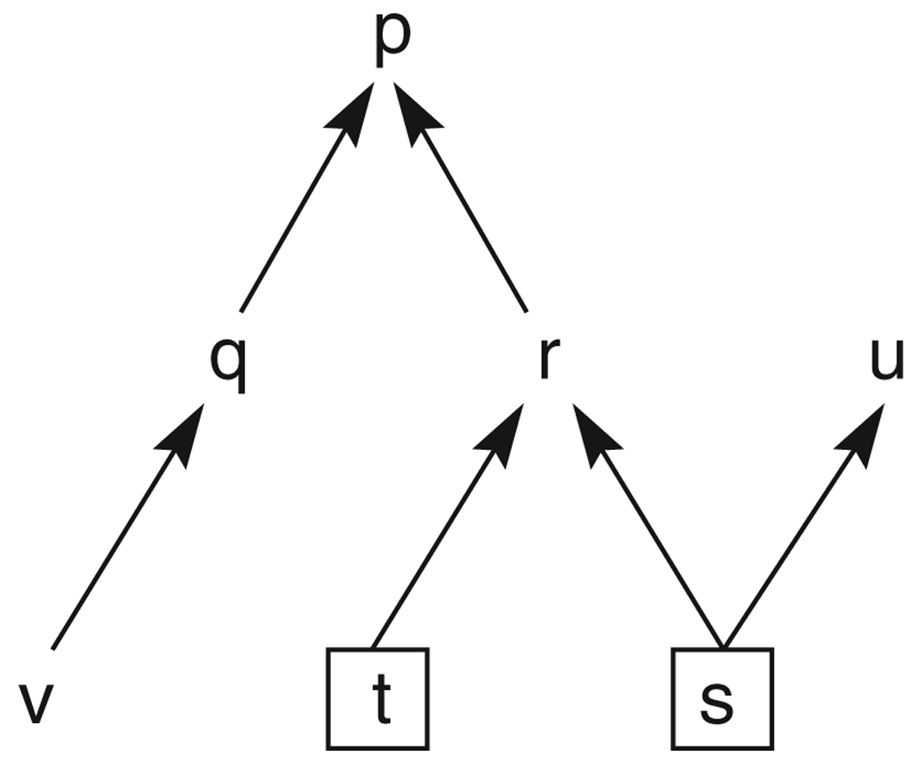
Draw a graph: Propositional calculus
Example: Define a graph from propositional calculus to view the logical relationships.
Translate into graph?
State space graph of a set of implications in the propositional calculus.
Reasoning:- How to infer p using moden ponens?
s , s -->r yields r
r , r -->p yields p
Notes:
Modus Pones: Alpha, alpha → Beta / Beta

Slide 45
Activity 2: From propositional calculus to a graph
Give a set of propositional calculus expressions, you are required to draw a graph.
a
b
c
a → e
c → e
b → f
c → f
f → g
Draw graph
Notes:
Modus Pones: Alpha, alpha → Beta / Beta

Slide 46
Activity 2: From propositional calculus to a graph
Give a set of propositional calculus expressions, you are required to draw a graph.
a
b
c
a → e
c → e
b → f
c → f
f → g
g
Draw graph
e
f
a
c
b
Notes:
Modus Pones: Alpha, alpha → Beta / Beta

Slide 47
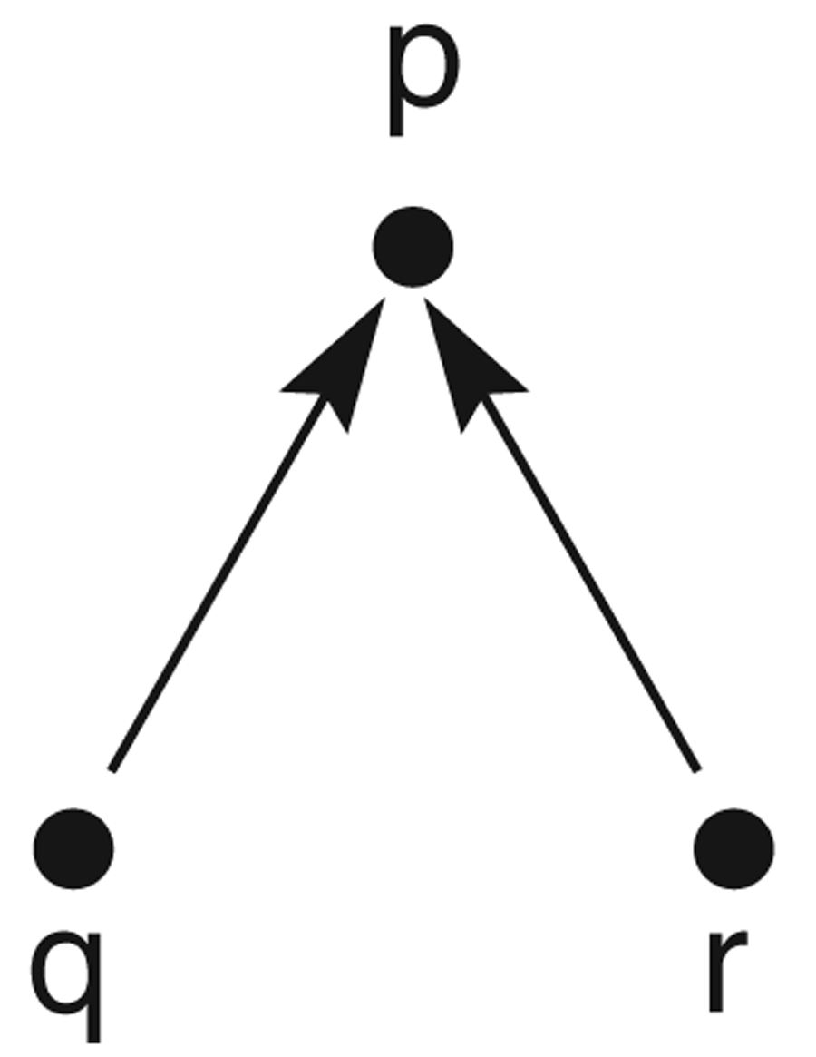
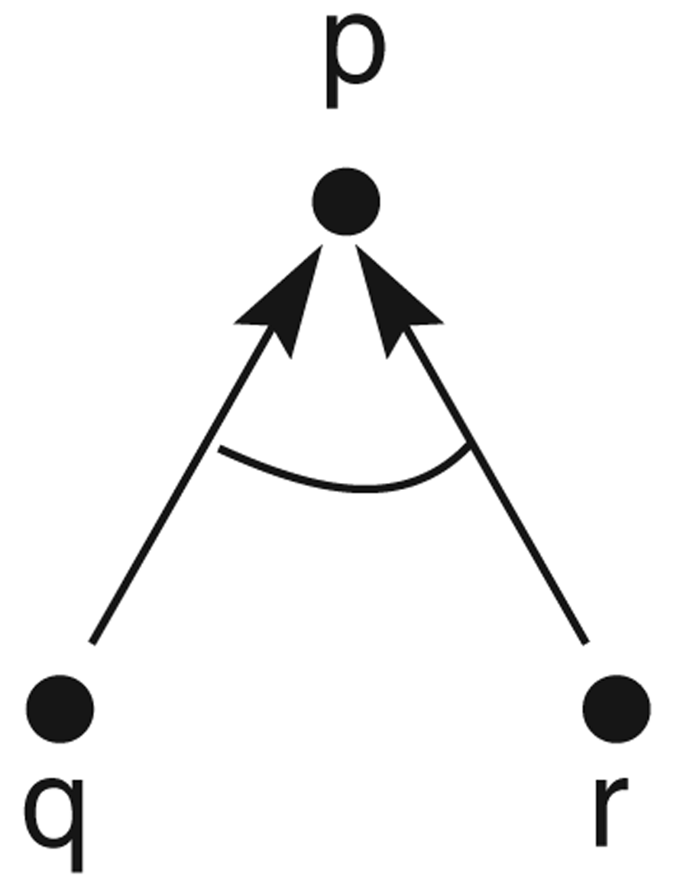



And/or graph
To represent logical operators AND and OR in predicate calculus
extension of basic graph model known as and/or graph
To differ the relationships graphically, curve link indicates operator AND.
q r p
q r p

Slide 48
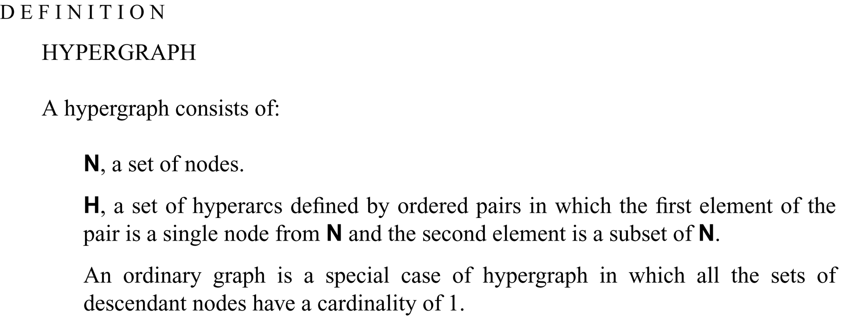
Hypergraph
AND/OR graph is a specialization of a type of graph known as hypergraph, which connects nodes by sets of arcs rather than a single arcs

Slide 49
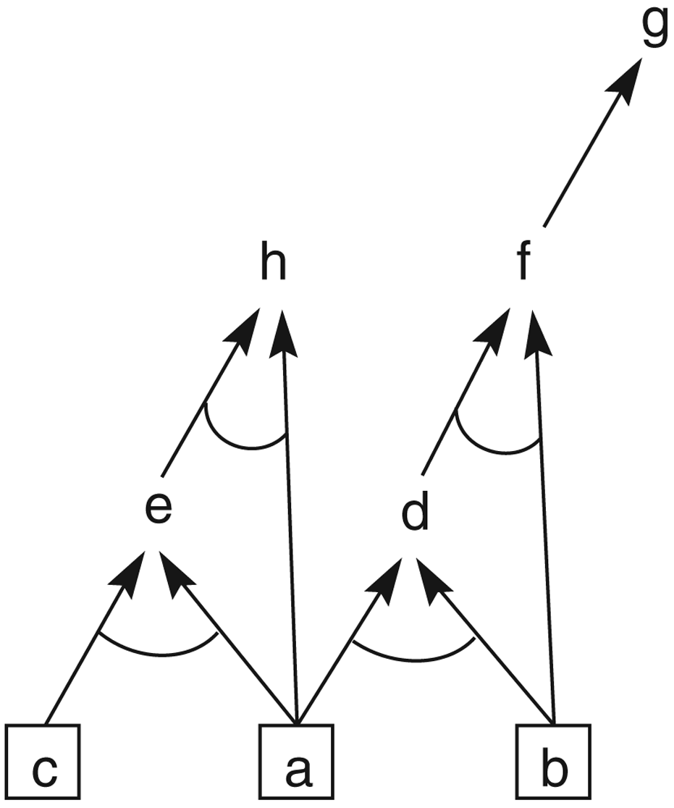
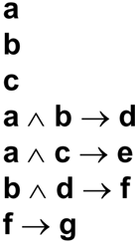
Hypergraph
eg. And/or graph of a set of propositional calculus expressions.
Draw the and/or graph

Slide 50
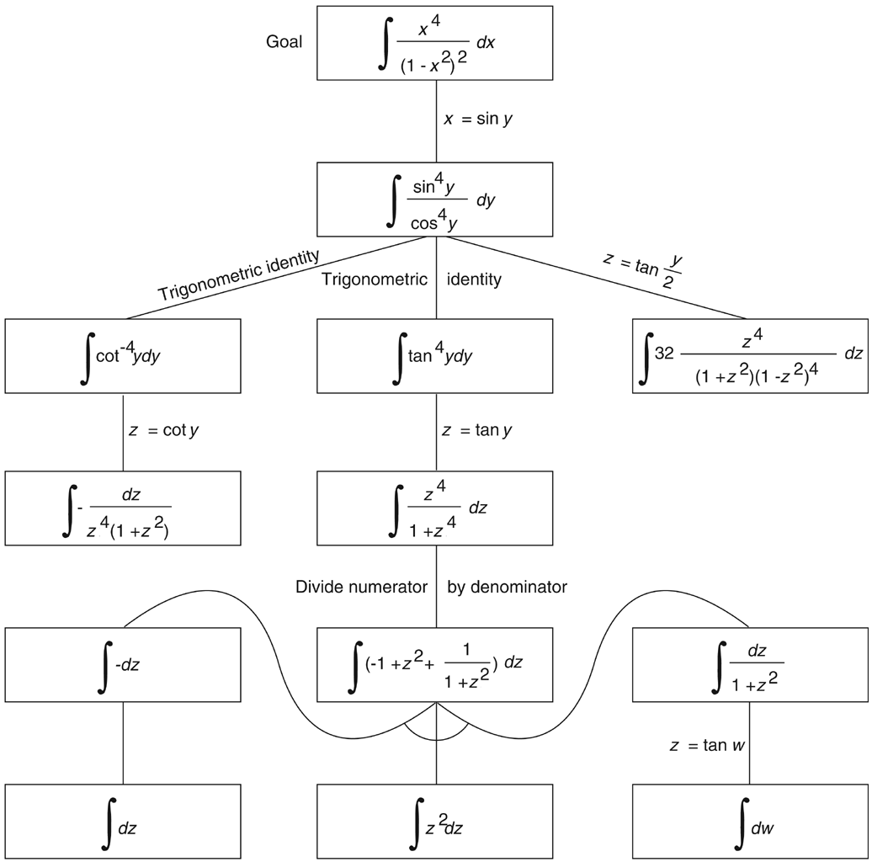
Hypergraph
More example:
And/or graph of part of the state space for integrating a function, from Nilsson (1971).
Goal-directed search

Slide 51
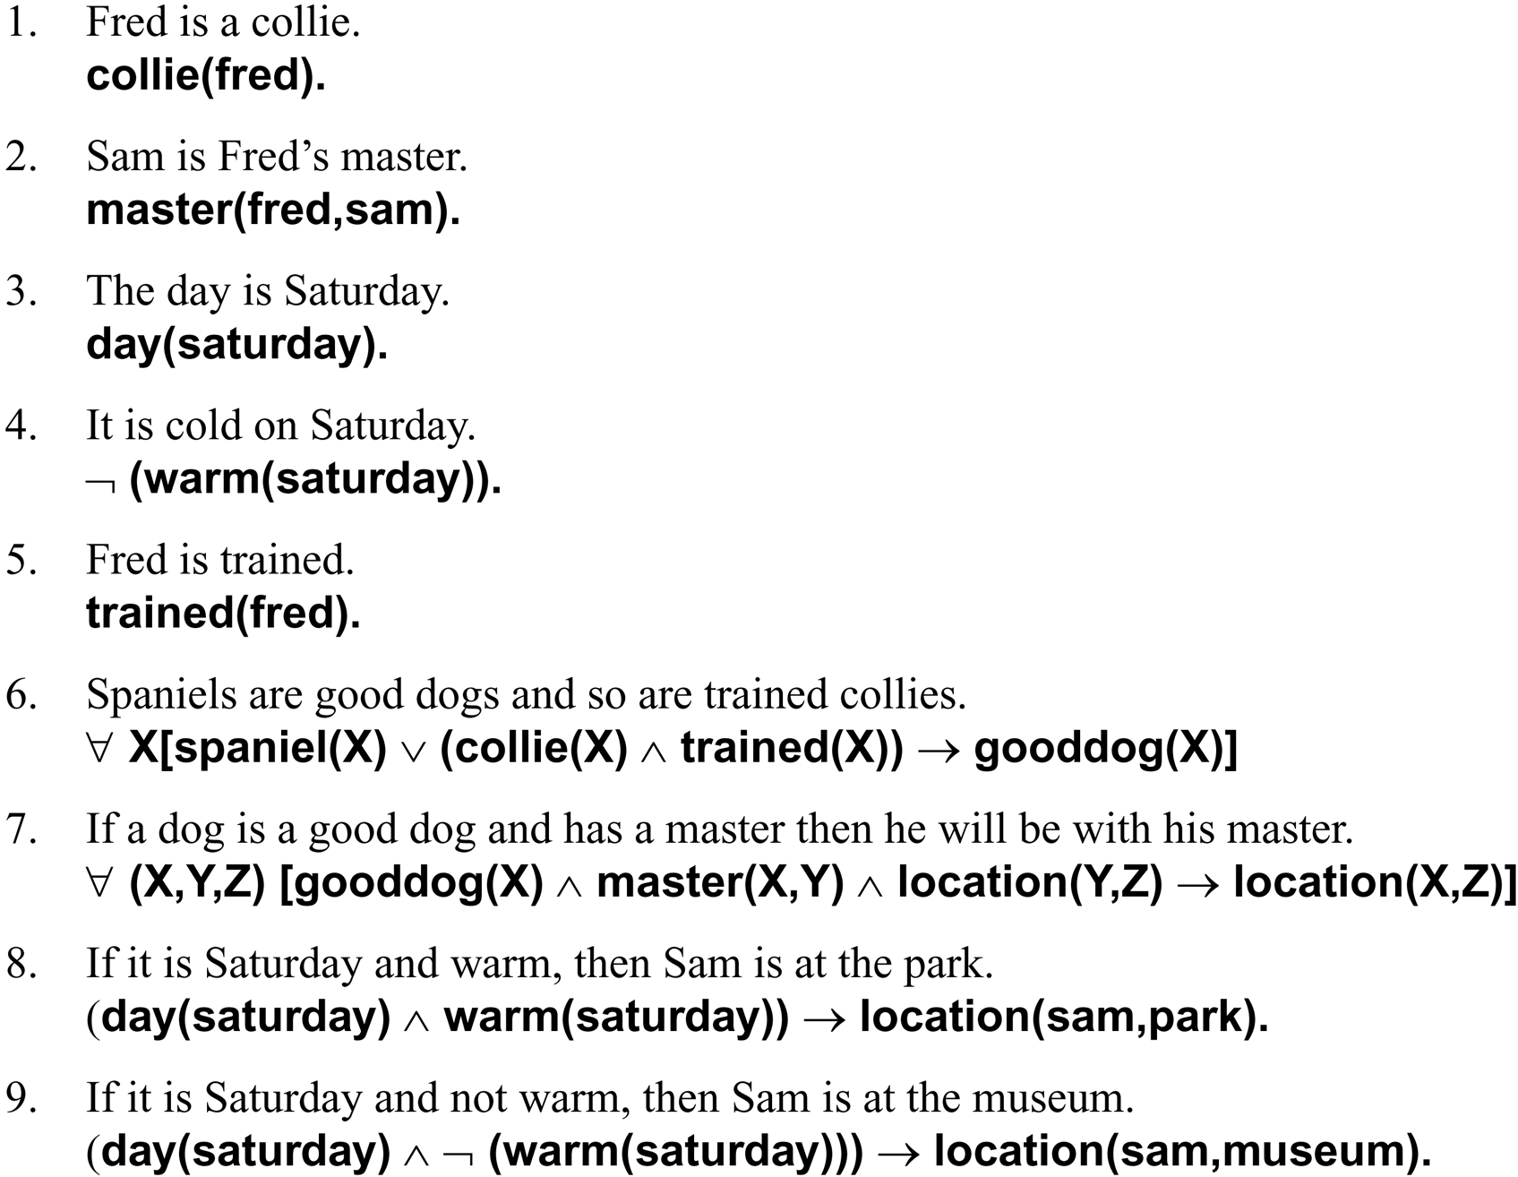
Hypergraph
More example:
Where is Fred??
The facts and rules of this example are given as English sentences followed by their predicate calculus equivalents:

Slide 52
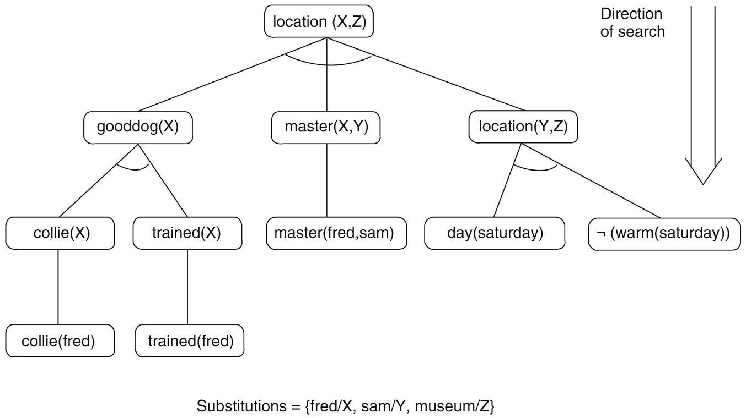
Hypergraph
Where is Fred???..The solution subgraph showing that fred is ???
at the museum
Goal-driven search using predicate calculus

Slide 53
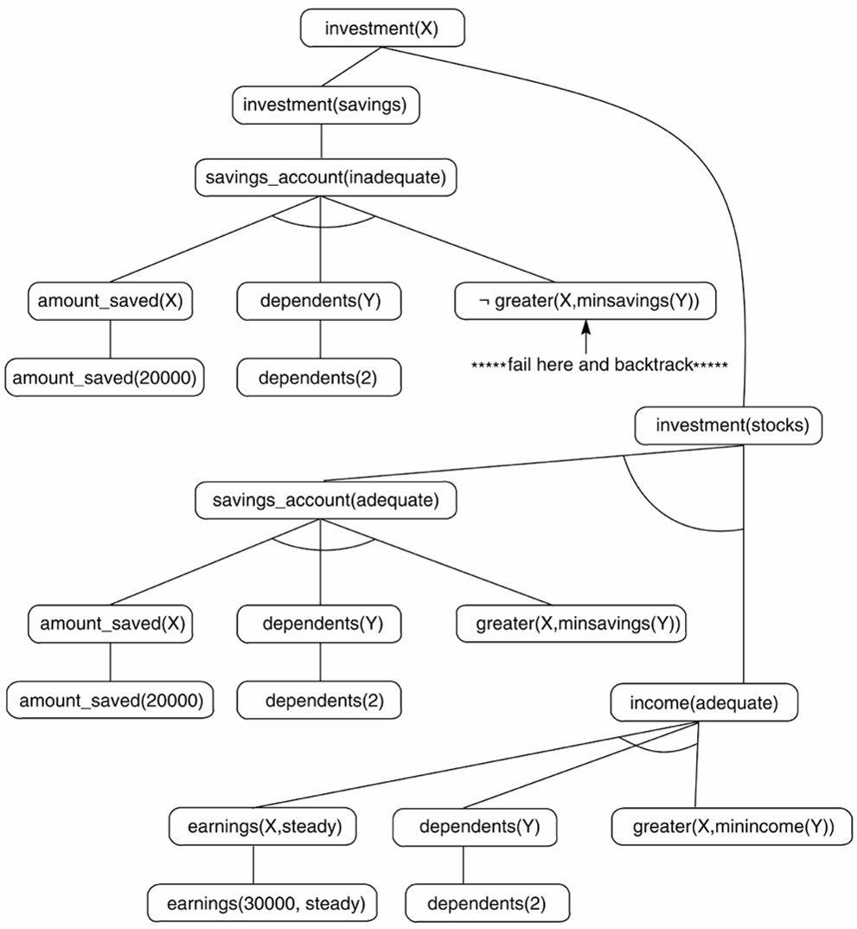
Hypergraph
More example:
Financial advisor
And/or graph searched by the financial advisor.

